Slide 1

Usability Engineering

Slide 2
What is a usability?

Slide 3
What is a usability?
ISO 9241-11: “the extent to which a product can be used by specified users to achieve specified goals with effectiveness, efficiency and satisfaction in a specified context of use.”

Slide 4
Notes:
When can I park here?

Slide 5
Notes:
Do you click “ok” or “cancel”? Does clicking “cancel” cancel the “cancel” or does it confirm the cancel?

Slide 6
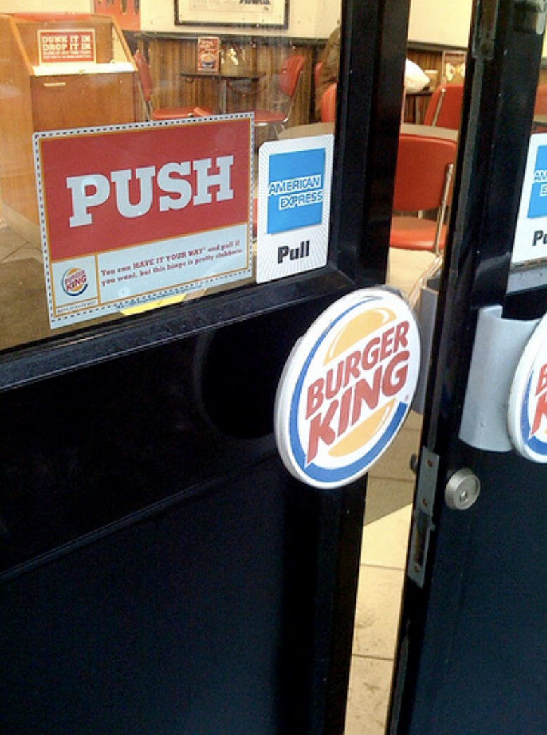

Slide 7
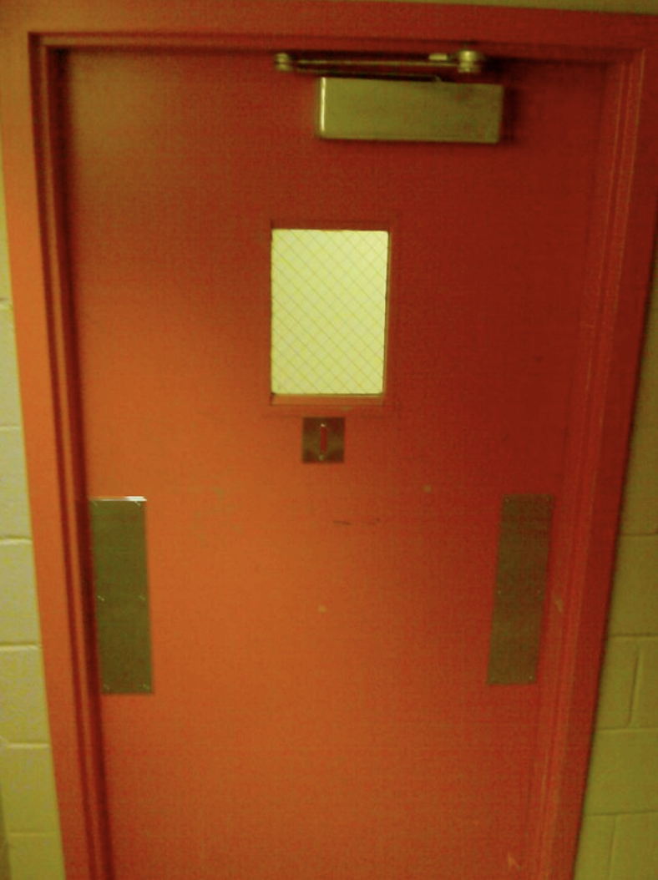

Slide 8
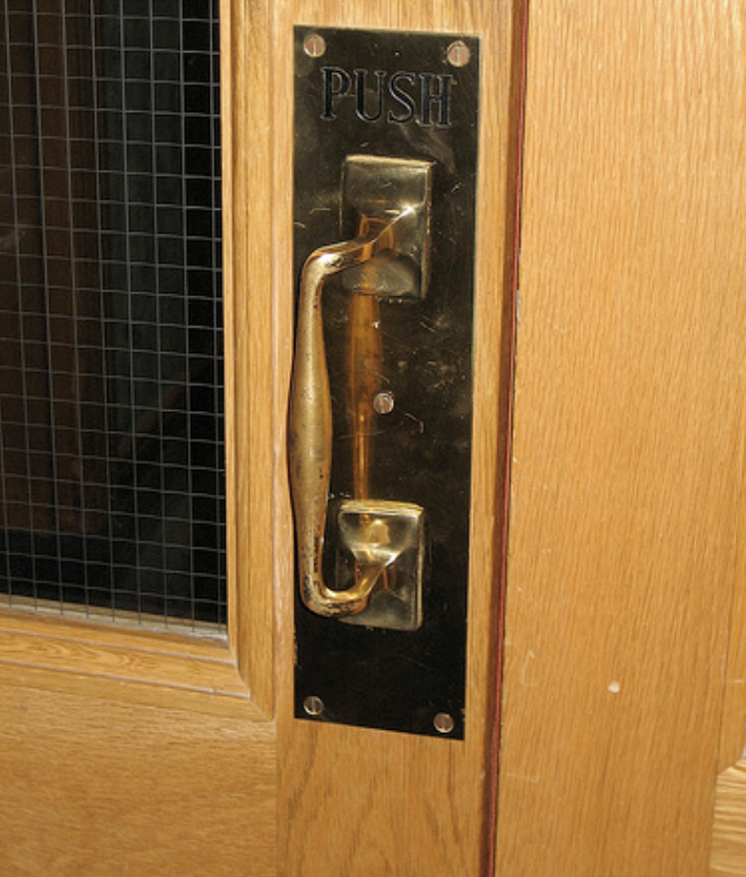

Slide 9
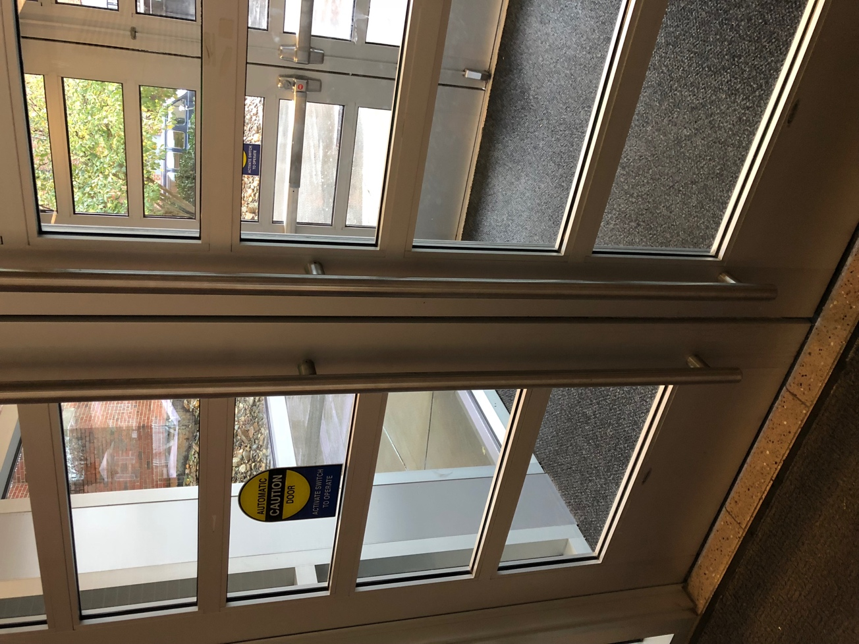
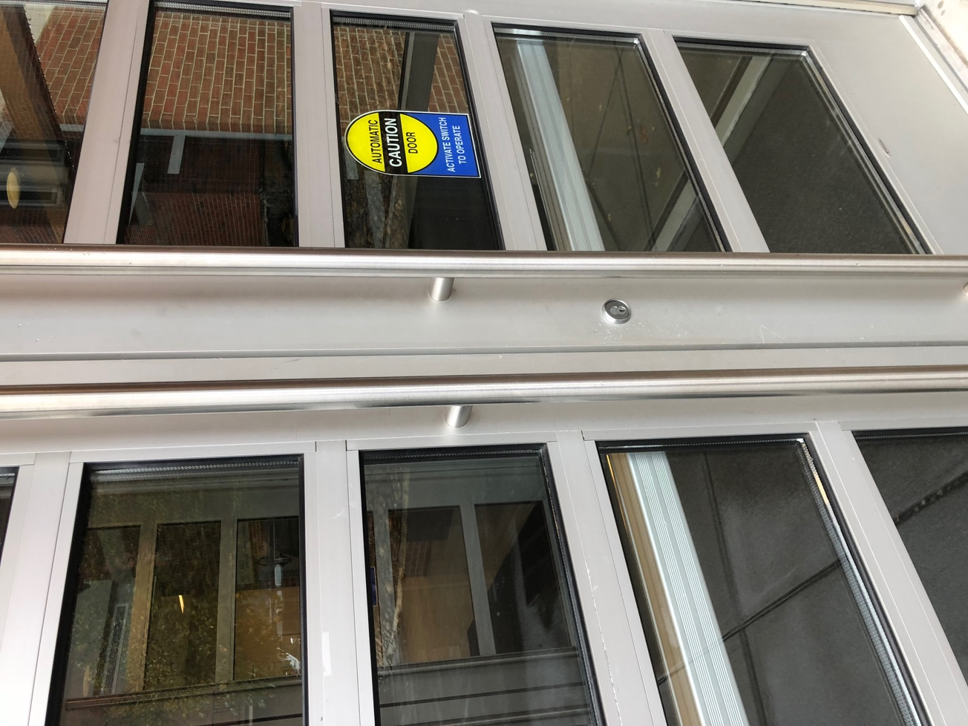
Same handle! Different action?
Notes:
These doors haunted me for a while.

Slide 10
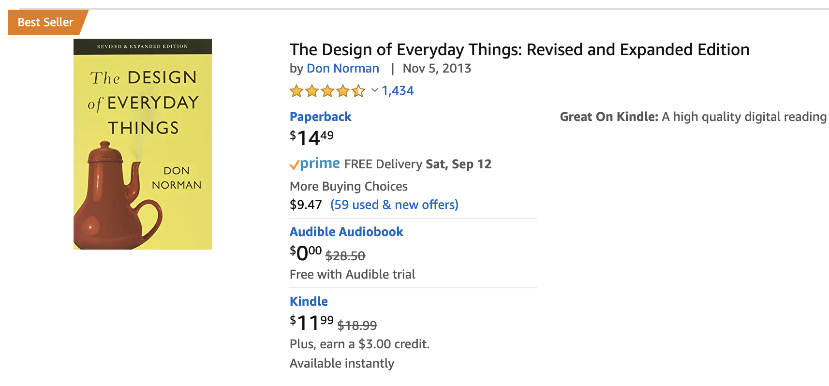
#1 book I would recommend to any engineering student

Slide 11
Ok, innocent enough. But can anything bad happen?
Notes:
Give me some examples!

Slide 13
Therac-25

Slide 14
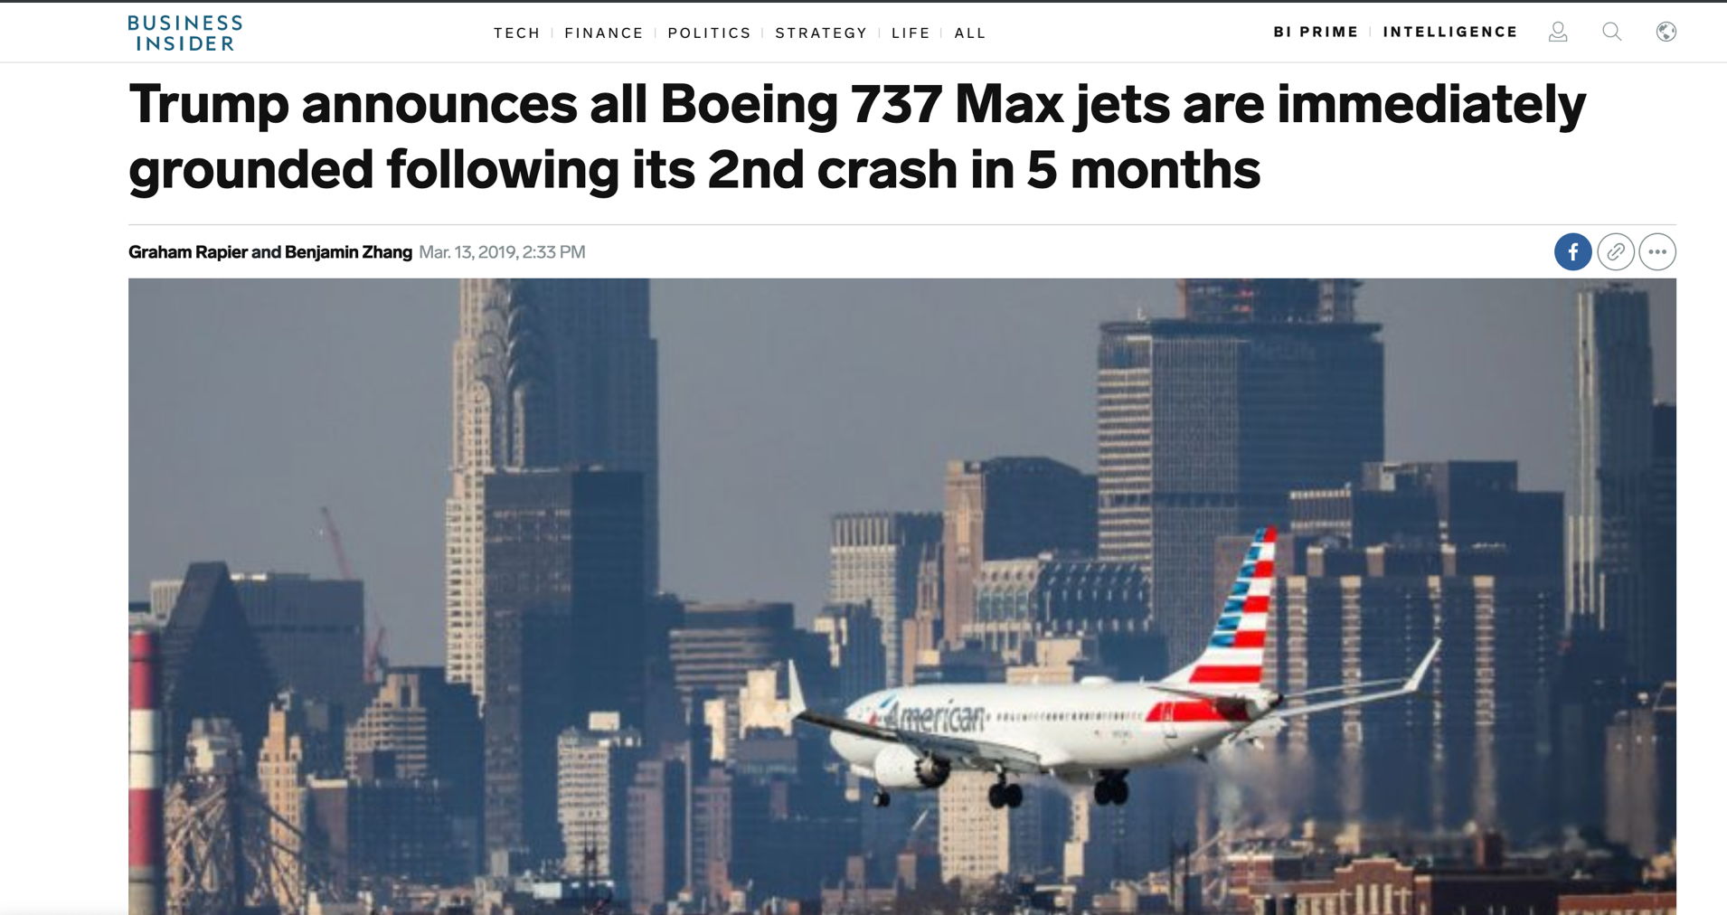

Slide 15
Ever take a look at elevator button panels?

Slide 16
Notes:
What is LL? G?
Why is there a G and a 1?

Slide 17
Notes:
This time we have 1 and no G. What is 2R? PB? PG? What are the colors?
No numbers?? Colors… but B and H have the same color.

Slide 18
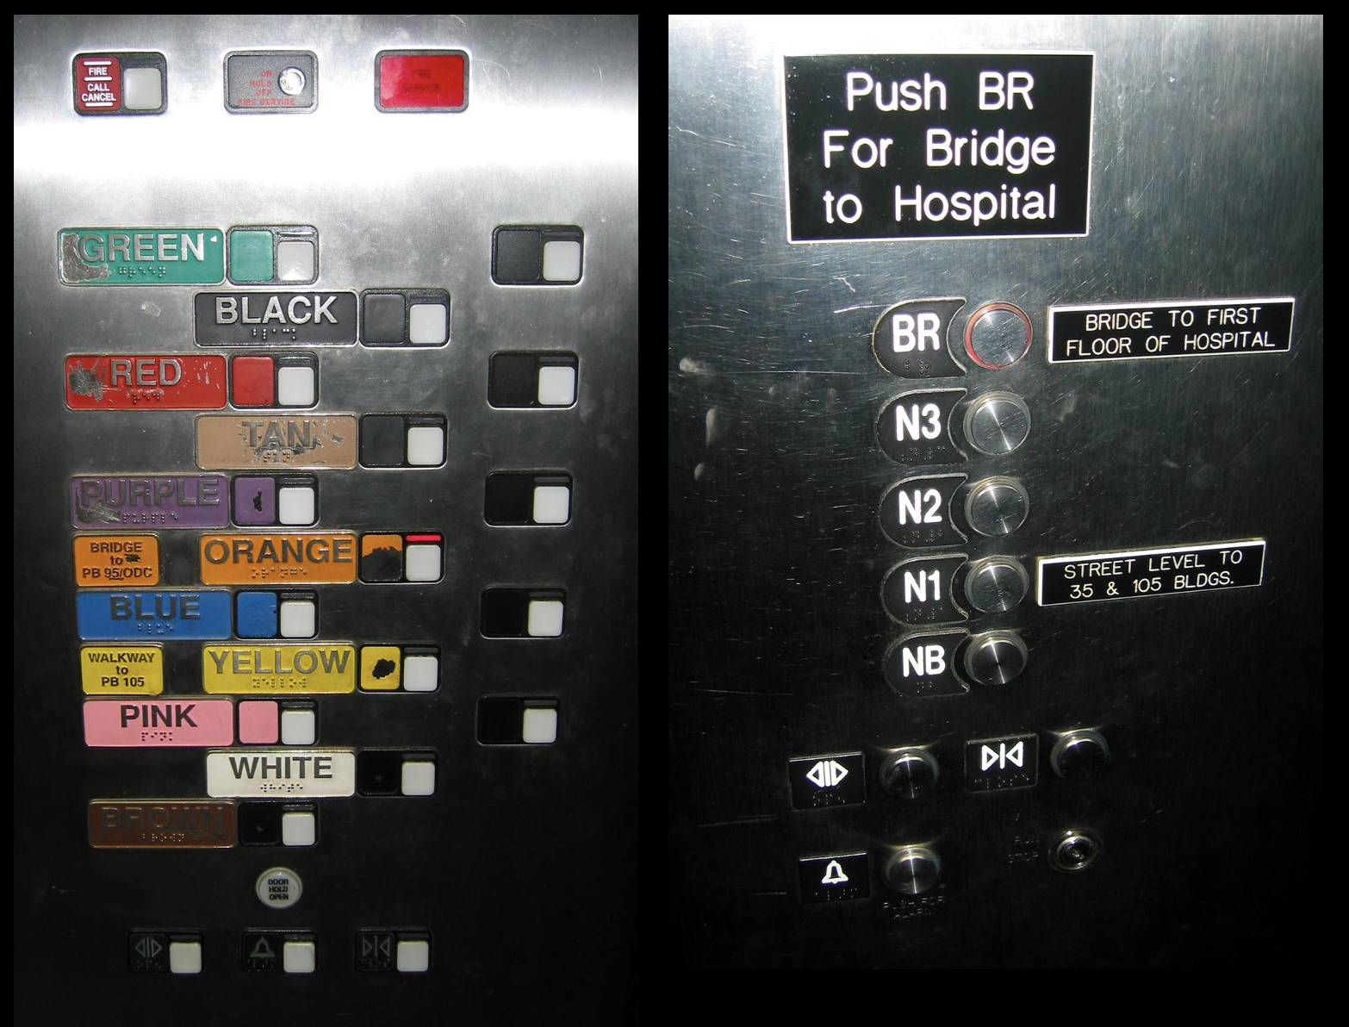

Slide 19
Notes:
Floor buttons aren’t horrible (1 is below L? How are there two P2s?)
But what are the other buttons…

Slide 20
Did you read the instructions?
Notes:
How did you learn how to work these?

Slide 21
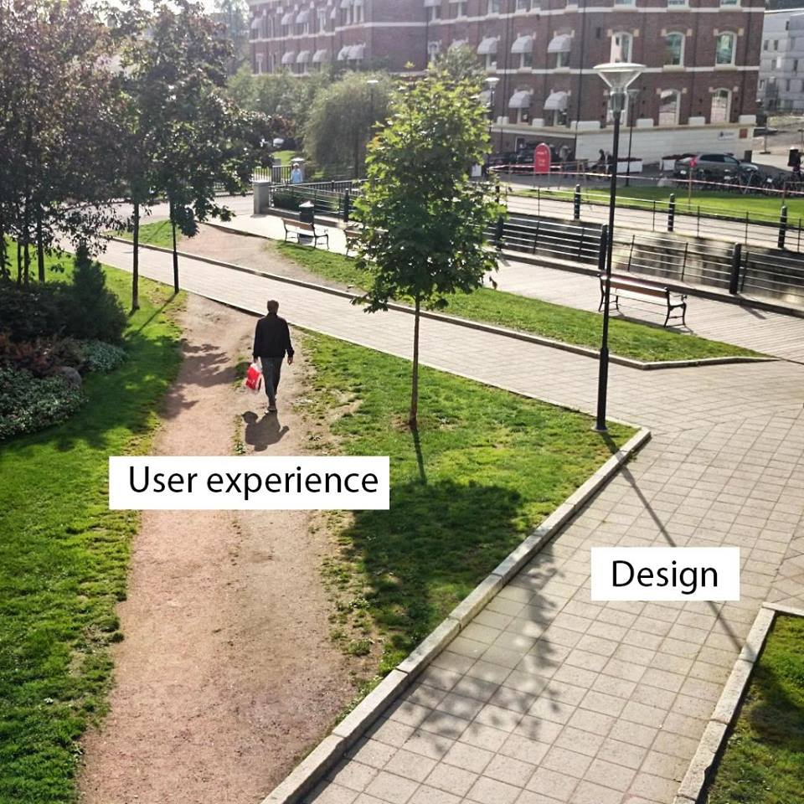
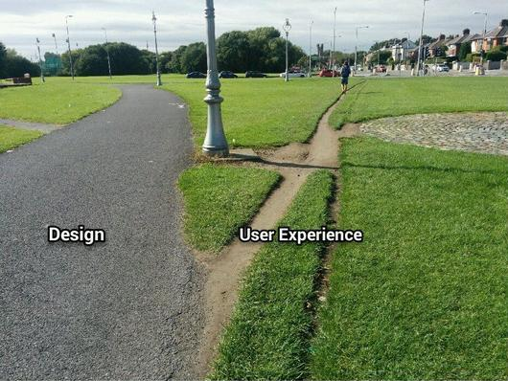
Design for people

Slide 22
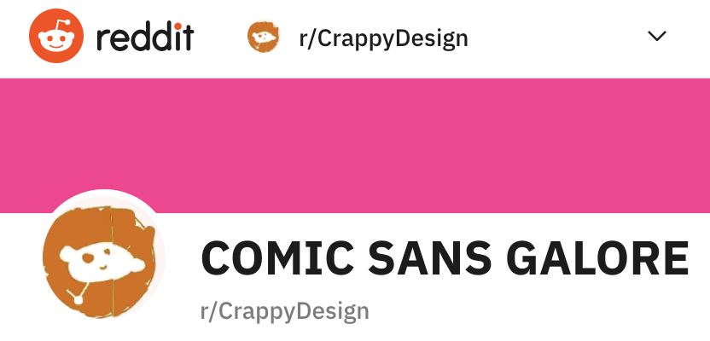
For more funny examples of bad design…

Slide 23
What usability problems have you
seen with software?

Slide 24
How do we test usability?
Intuition?
Test on ourselves?
Copy interface from other apps?
Not worry about it until someone dies?

Slide 25
Test with actual USERS
Put your app in front of actual people
Can they figure it out?
How long does it take them?
Do they need help?
How they behave != how you want them to behave
Don’t blame the user!
Blame the design and go fix it!

Slide 26
How do you measure usability?
Imagine your group project…
How do you measure whether it is usable?
How do you test it with people?

Slide 27
Aspects of Usability
Learnability
Efficiency
Satisfaction
Memorability
Errors

Slide 28
Learnability
Can users learn to correctly use it?
Can unfamiliar users pick it up?
Can power users learn to become experts with it?
How to provide the right guidance to help users?
They won’t read instruction books!
Wizards?
Visible & labeled buttons

Slide 29
Notes:
Could use wizards to guide them through complex processes.

Slide 30
Notes:
Could provide suggestions and templates to common tasks.

Slide 31
Design constraint:
Don’t overwhelm the user
Make it easy to find features

Slide 32
How could we measure learnability?

Slide 33
Aspects of Usability
Learnability
Efficiency
Satisfaction
Memorability
Errors

